Slide 1

Learn. Imagine. Build. .NET Conf
What’s New in Visual Studio 2017
Kasey Uhlenhuth, Program Manager
@kuhlenhuth

Slide 2
Agenda
What is Roslyn
Investment in performance and reliability
Demo: productive right out of the box
What’s coming next

Slide 3
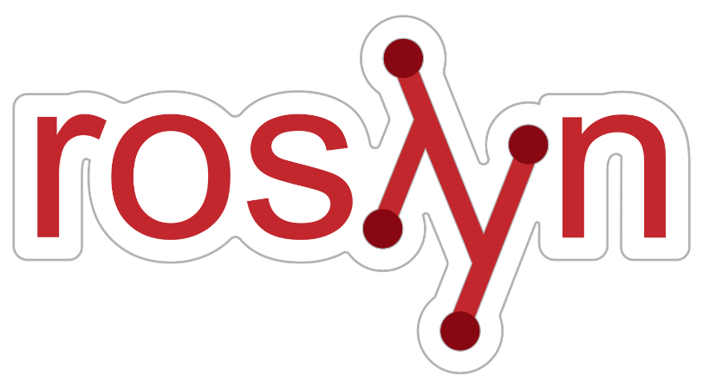
What is Roslyn?
C# and Visual Basic compiler
Shipped with VS2015

Slide 4
Why Roslyn?
Write new features faster
Provide open source API

Slide 5

Visual Studio 2017…
is the first major release of Visual Studio since we completed the Roslyn project!

Slide 6
Performance and Reliability
Constant monitoring of crash and hang rates
Steps to improve perf for large solutions
Fast, lightweight install

Slide 7
Things we’ve done to save you time
Moved analysis out of VS process
Made a switch for full-solution analysis
Improved solution load
Faster, lightweight install experience

Slide 8
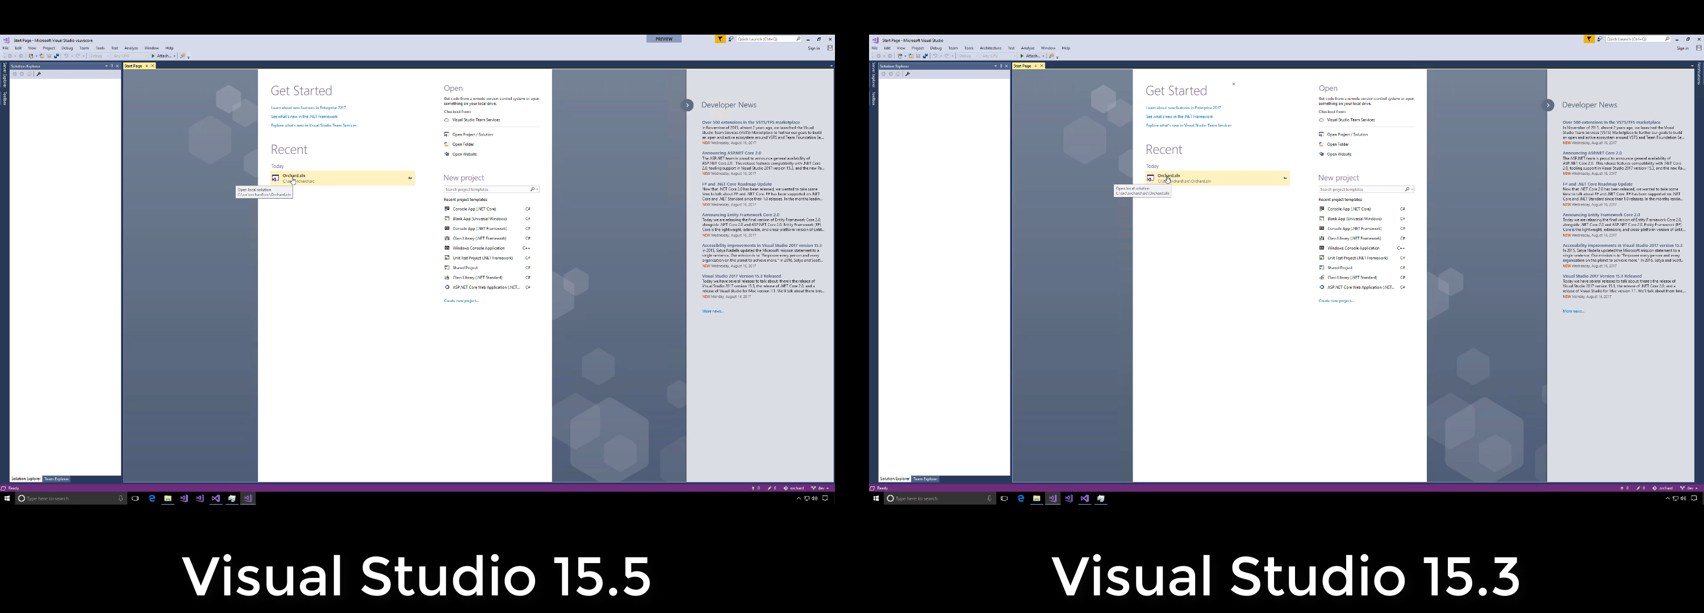
Solution Load Improvements
Notes:
The key message is that we optimized solution load time for large C# solutions in 15.5.
Project load and desing-time build in parallel

Slide 9
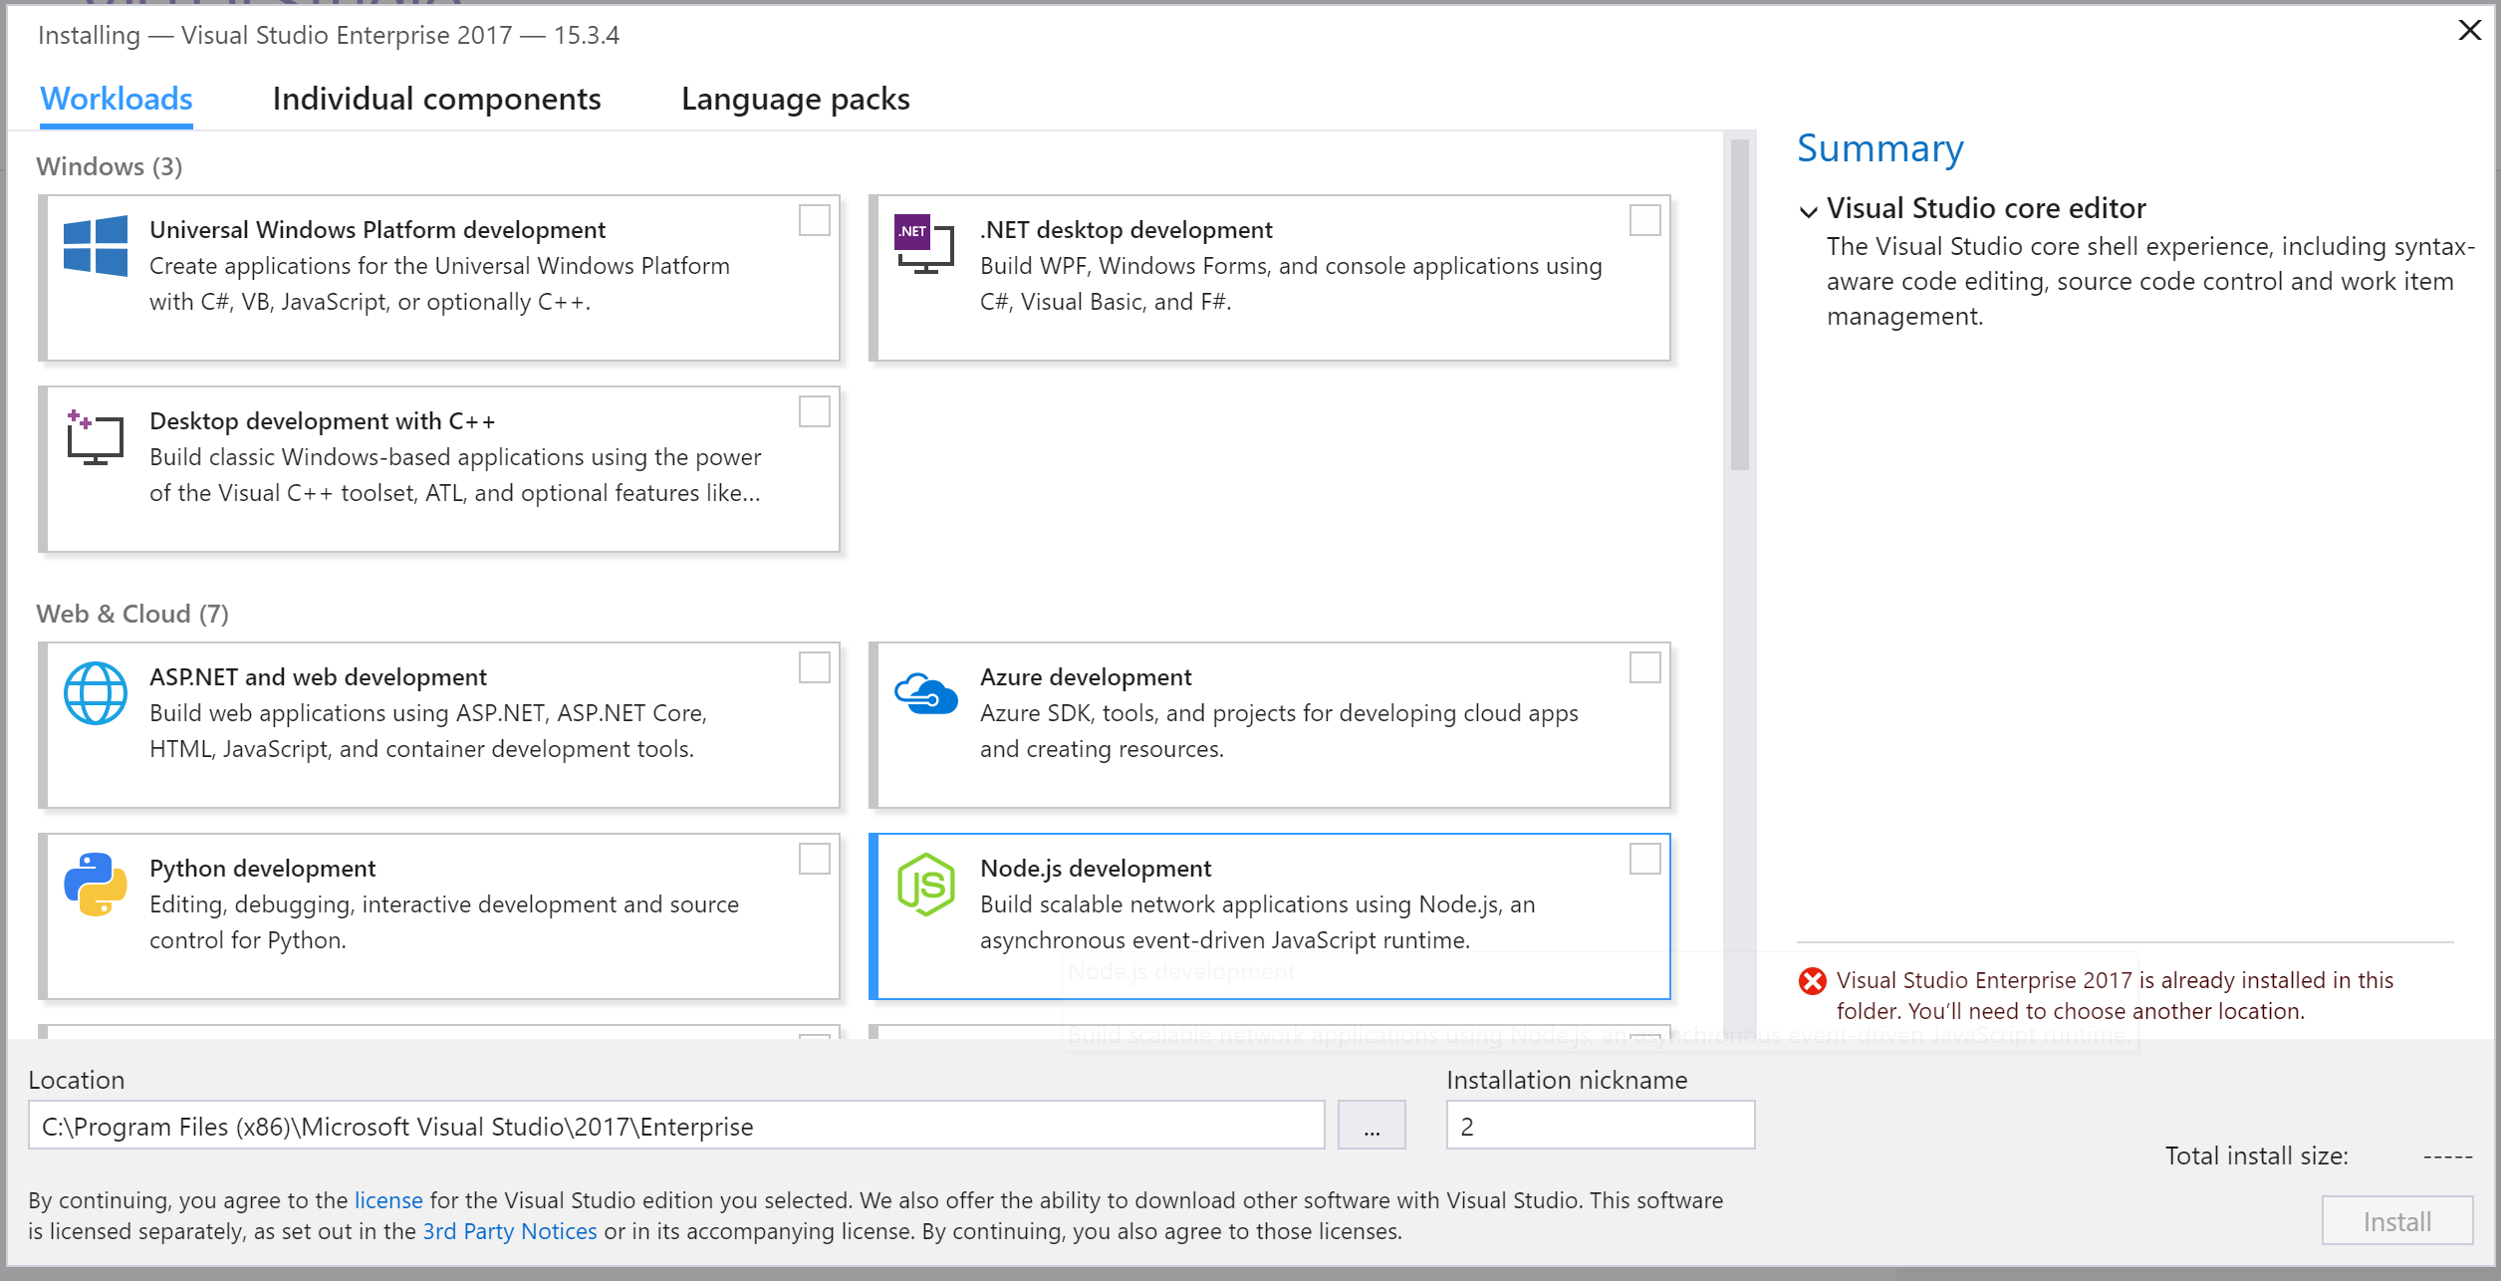
Install Experience

Slide 10
Demo: be productive right away
Notes:
It highlights that we’re OSS, and that we’re trying to leverage other OSS, instead of writing things ourselves

Slide 11
Visual Studio 2017 Recap
Help developers write better code faster.
More refactorings and quick fixes
Navigation improvements
Live unit testing
Debugging enhancements
Code style enforcement and configuration
IntelliSense improvements

Slide 12
What’s coming next…
Even more refactorings and quick fixes
Convert for-loop to LINQ
Adjust namespaces
Navigation to decompiled sources
Calling out dead code
Razor support for quick fixes/navigation
Classification of locals, fields, etc.
Completion for types without usings
One-click code cleanup

Slide 13



Onboarding Experience
Faster install experience
Coding conventions travel with source
Many refactorings included

Slide 14
Resources
File feature requests/bugs: https://github.com/dotnet/roslyn/issues
Productivity cheat sheet: https://aka.ms/vs2017productivityguide
Productivity overview: https://www.visualstudio.com/vs/net-productivity/
Coding convention configuration/enforcement: https://docs.microsoft.com/en-us/visualstudio/ide/editorconfig-code-style-settings-reference
Refactorings and code fixes in Visual Studio: https://docs.microsoft.com/en-us/visualstudio/ide/refactoring-code-generation-quick-actions
Write your own custom analyzer and code fix: https://github.com/dotnet/roslyn/wiki/Getting-Started-Writing-a-Custom-Analyzer-&-Code-Fix
What’s new in C# 7.0 : https://docs.microsoft.com/en-us/dotnet/csharp/whats-new/csharp-7

Slide 15
Related content
(Day 1) Keynote - Scott Hunter, Mads Torgersen, Miguel de Icaza
(Day 2) Supercharge your Debugging in Visual Studio -Kaycee Anderson, Nikhil Joglekar
(Day 3) Getting Started with .NET Part 1 & 2 - Scott Hanselman, Kathleen Dollard
(Day 3) C# Part 1 & 2 - Introduction to C# - Bill Wagner
(Day 3) Get started with F# and .NET Core - Phillip Carter

Slide 16
.NET

